Slide 1


MASS DIGITISATION
CAN WE PLAY IT?
Agnieszka Leszyńska

Slide 2
MASS DIGITISATION - ASSUMPTIONS
COVERS BOTH MAKING DIGITAL COPIES AND GIVING ACCESS
ASSUME:
REDUCED HUMAN INTERVENTION IN MATERIAL SELECTION
REDUCED HUMAN INTERVENTION IN DIGITISATION
NO FULL TEXT CORRECTION
AUTOMATIC DISPLAY
NO PRIOR RIGHTS CLEARANCE

Slide 3
CAN WE AFFORD IT?
CULTURAL HERITAGE MEANS A VARIETY OF MATERIAL
NEED TO CREATE COLLECTIONS
DUBLETS
RESTRICTIONS IN GIVING ACCESS
FOUNDING ISSUE

Slide 4

HOW DO WE DO IT

Slide 5
– LEGAL BASE
Protection of the Intellectual Property Rights and Related Rights Act dated 4th of April 1994; fair use section
Art. 28.
Libraries, Archives and Schools are permitted to:
give free access to the already published material according to the institution’s statue;
reproduce already published material for purposes of preservation, replacement copies, protection of the own collection;
give free access to the digitised collection for the scientific and knowledge purposes on computers inside the institution.

Slide 6
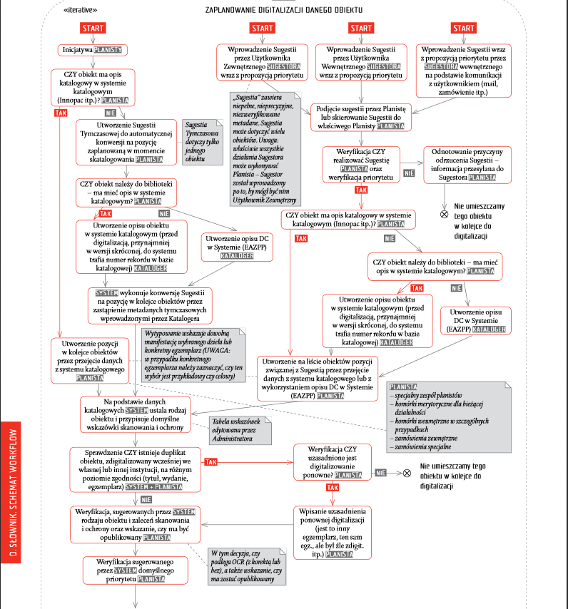
– LARGE SCALE DIGITISATION
WORKFLOW

Slide 7
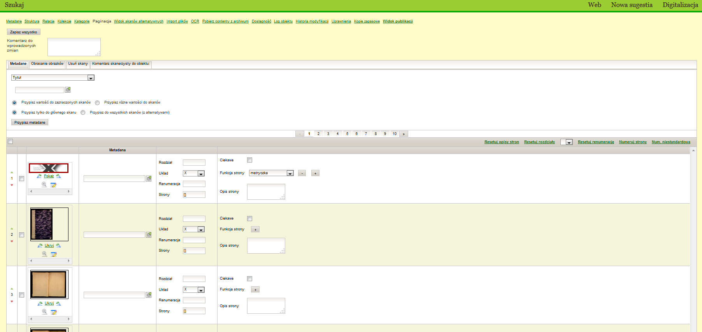

– LARGE SCALE DIGITISATION
SYSTEM IMPLEMENTATION
300 000 digitised objects
almost 7 000 000 scans
145 000 objects in POLONA

Slide 8
– LARGE SCALE DIGITISATION
GIVING ACCESS
WHAT BELONGS TO PUBLIC DOMAIN STAYS IN PUBLIC DOMAIN
highest resolution
no water marks

Slide 9

– LARGE SCALE DIGITISATION
GIVING ACCESS
COPYRIGHTED MATERIAL
70 YEARS AFTER CREATOR’S DEATH
30 YEARS AFTER FIRST EDITION OF THE MATERIAL BELONGING TO THE PUBLIC DOMAIN NOT BEING PUBLISHED BEFORE
70 YEARS FROM THE PUBLICATION OF THE NEWSPAPER OR SERIAL UNLESS IT CONTAINS PICTURES OR TEXTS THAT ARE PROTECTED AS THE SEPARATE UNITS

Slide 10

CONTEMPORARY HERITAGE IS PROTECTED
FREE ACCESS IN THE OPEN INTERNET IS PROHIBITED

Slide 11

GIVING ACCESS - SOLUTIONS
NON-EXCLUSIVE LICENCES
Authors/Publishers are asked for permission for
MAKING DIGITAL COPIES
PROVIDING ACCESS IN THE OPEN INTERNET IN THE WAY SUITABLE FOR THE USERS
USING DIGITISED MATERIAL FOR THE PROMOTIONAL PURPOSES AND IN PUBLIC PRESENTATIONS, INCLUDING RADIO AND TELEVISION BOADCASTING

Slide 12
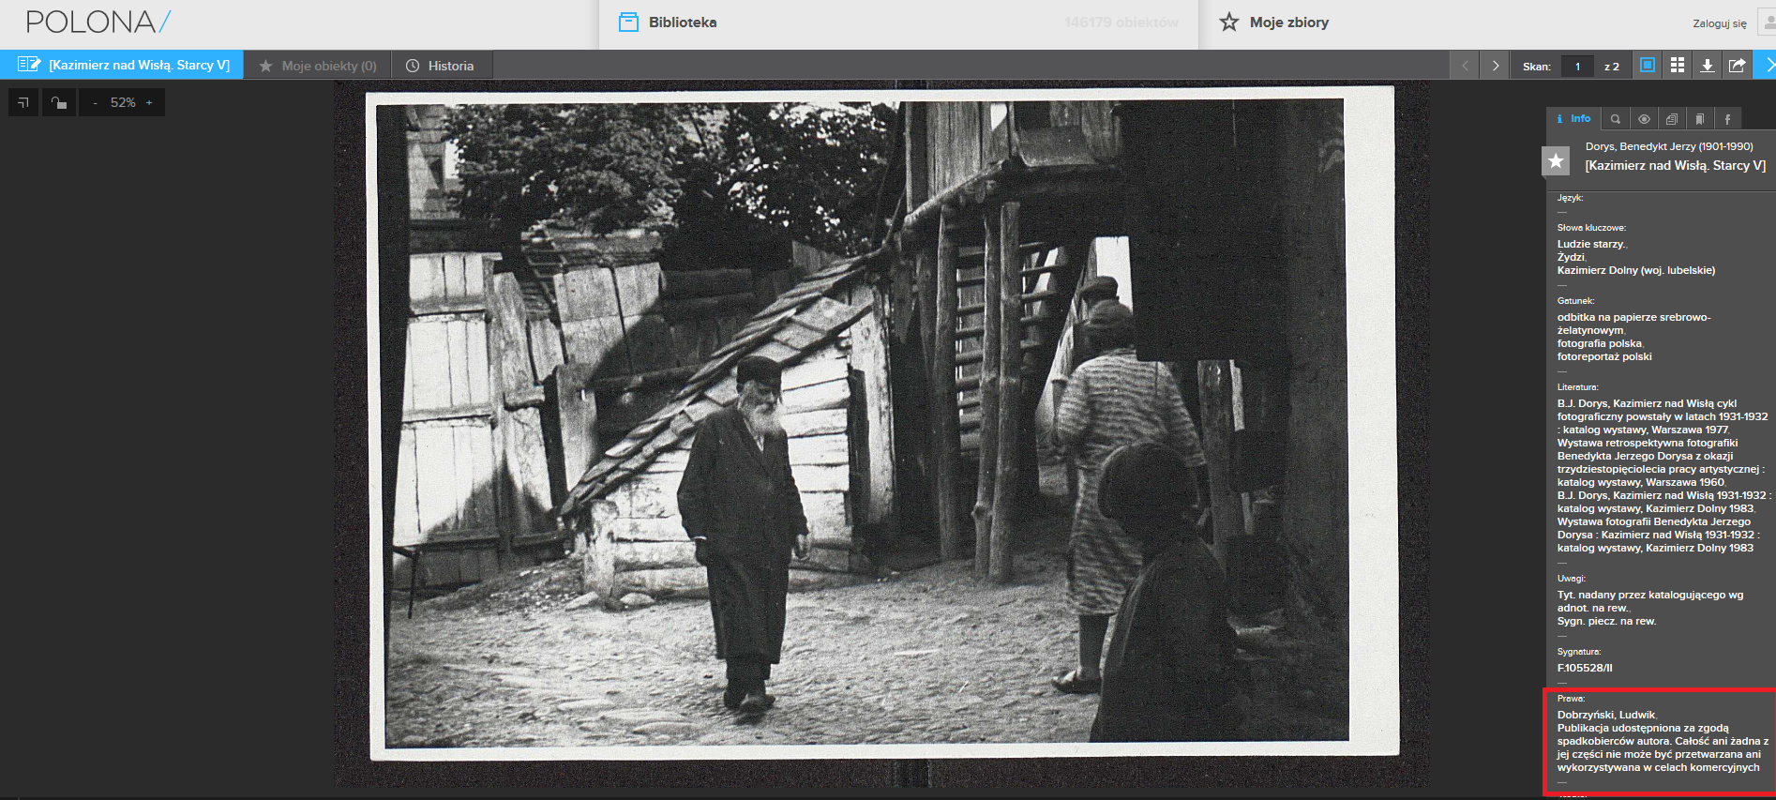

NATIONAL LIBRARY INFORMS USERS THAT THE MATERIAL IS LICENCED, AVAILABLE FOR THE FAIR USE,
COMMERCIAL USE IS PROHIBITED

Slide 13

GIVING ACCESS - SOLUTIONS
SUPPORT FROM THE MINISTRY OF CULTURE
LONGTERM GOVERNMENTAL PROGRAMME KULTURA +
RANKING SYSTEM FOR THE SCIENTIFIC MAGAZINNES

Slide 14
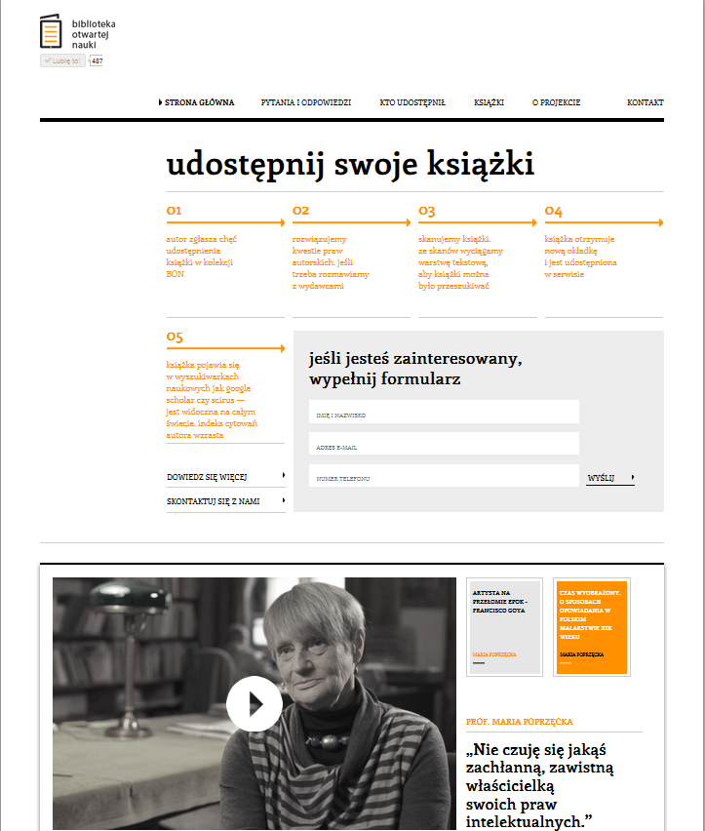
GIVING ACCESS - SOLUTIONS
COOPERATION WITH INSTITUTIONS DEALING WITH THE OPEN SCIENCE AND OPEN CULTURE

Slide 15

GIVING ACCESS - SOLUTIONS
DIGITAL LIBRARY OF THE SCIENTIFIC PUBLICATIONS ACADEMICA
digital base of books and scientific magazines
the interlibrary digital copies loan system
240 000 digital objects provided to the users on dedicated computers in the partner libraries

Slide 16

DREAM SOLUTION?
Reasonable regulations adjusting Intellectual Property Law
to the modern information society needs

